Slide 1
WELCOME TO MASS MOBILES
BEST SALES AND SERVICE IN INDIA
We are selling all new branded mobiles and laptops.

Slide 2
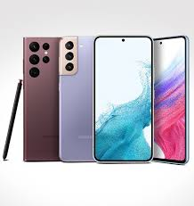
Mobiles and laptops
mobiles
visit
Apple I pro
Apple 14 series
Oppo
Realme & mi
Samsung & nokia
Nothing

Slide 3
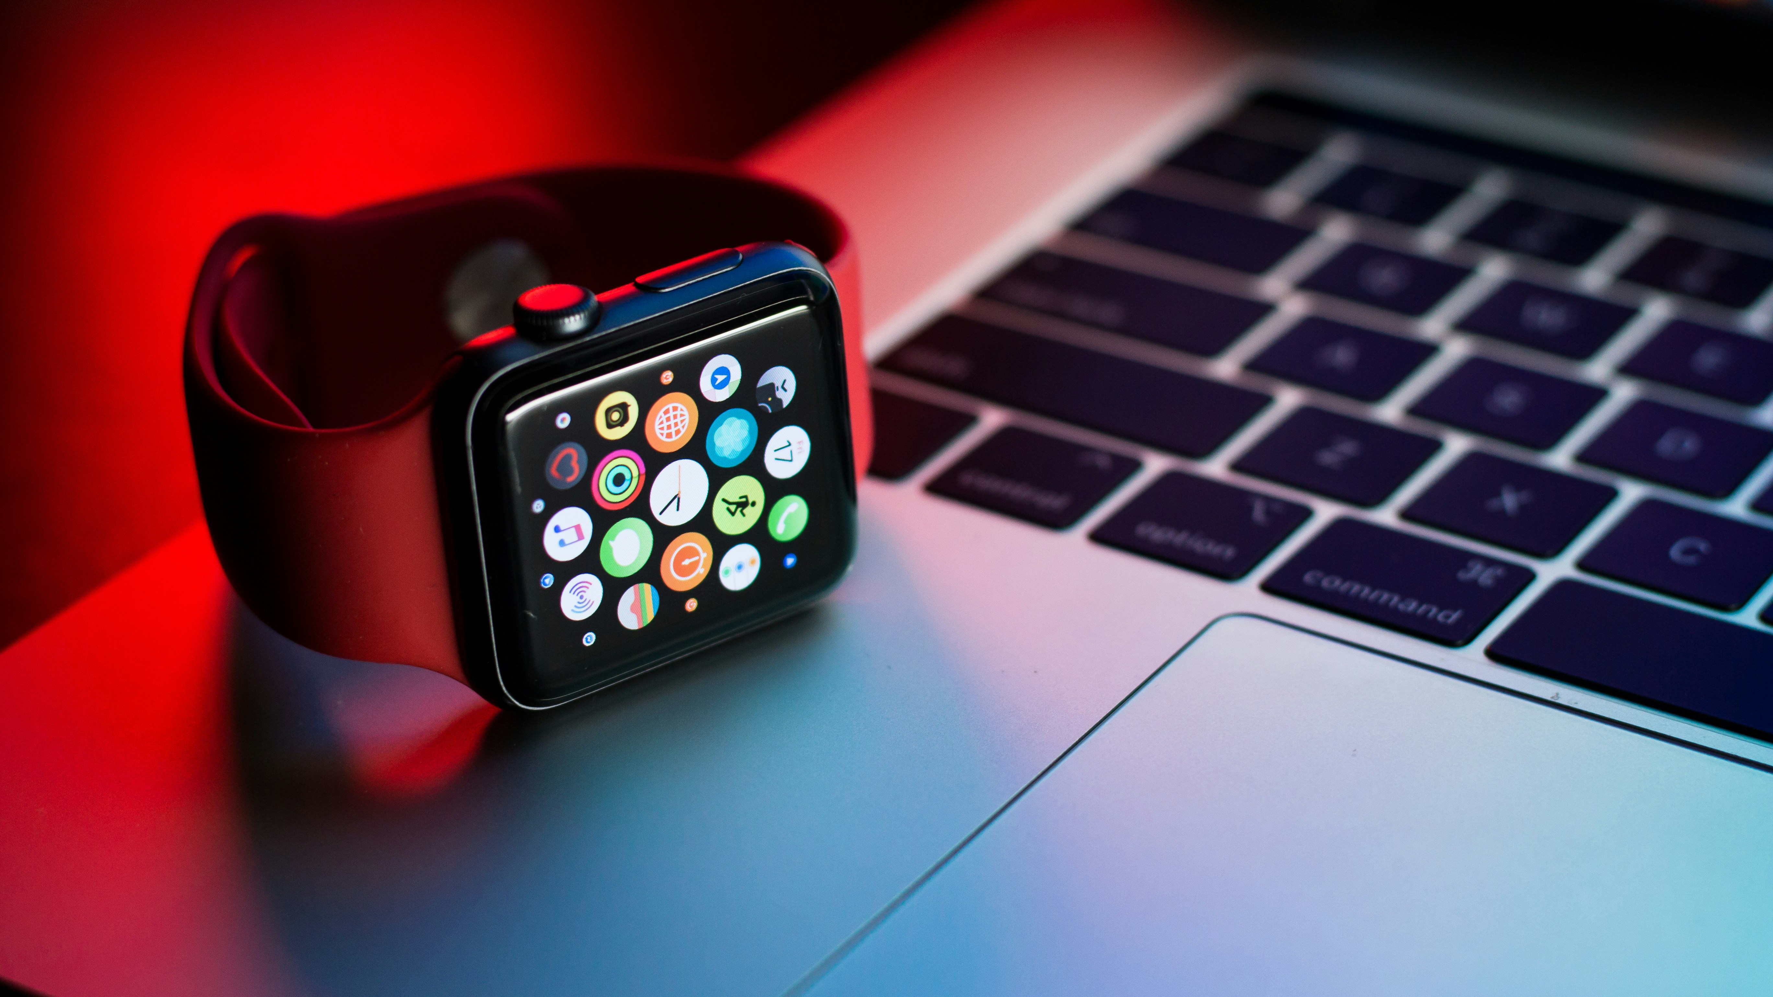
Mobile watches &laptops

Slide 4
Stay connected, entertained, and efficient with the latest mobiles and accessories! call, browse, capture moments, play games, and charge faster on the go. explore a wide range of top-brand smartphones and advanced accessories to enhance your daily life with ease and excitement. upgrade your experience today!

Slide 5

Mass mobiles sales & service is a Chennai based leading multi-brand retail chain for smartphones and gadgets in India with more than 470+ stores across various cities. founded by our esteemed founder and CEO Mr. S. Abu.

Slide 6
We are providing online purchase through our website. we have all brands of mobiles at affordable prices. we have service validity and free service to purchase online please visit our website by click the link http:///e:/www.mass mobiles.in Contact Us Phone- 123456789 Email id - abu17@gmail.com insta id - https://www.instagram.com/act_redirect Facebook- mass mobiles and go.

Slide 7
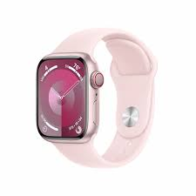
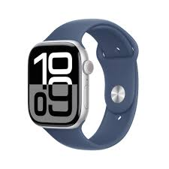
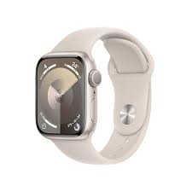
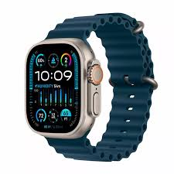

Slide 8
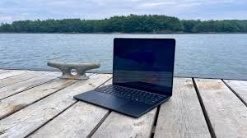
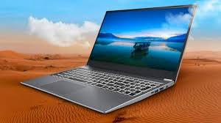

Slide 9
OUR BRANCHES Trichirappalli Perambalur Viruthachalam Labbaikudikadu

Slide 10

Thank you for watching

